Slide 1
Mini Project Final Review
- Antarjita Mandal
- Sai Shruthi S

Slide 2
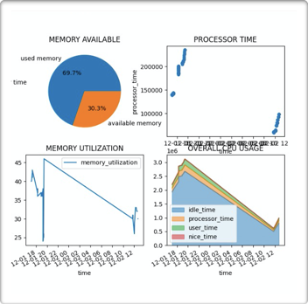
Abstract
The overall system resource utilisation during a particular time is retrieved and logged into a csv file.
The user is alerted incase of any threshold violations
Real time graphs are plotted to understand the trends
Models are constructed to predict the cpu and memory utilisation further on

Slide 3
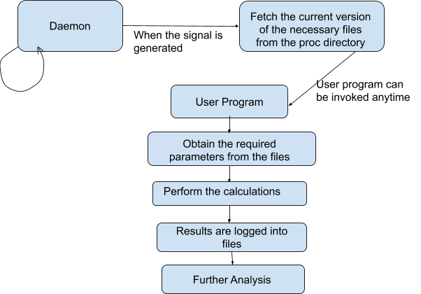
Work Flow

Slide 4
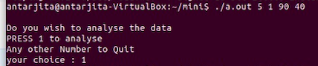
The daemon code keeps running in the background. Each time the alarm is expired, it will fetch the latest version of the proc files and the previous files will be discarded
The user program can be invoked as : ./a.out <number of times the proc file should be polled> <delay in seconds> < cpu threshold> <memory threshold>
After the user program completes execution, the user is given an option to visualise the results.

Slide 5
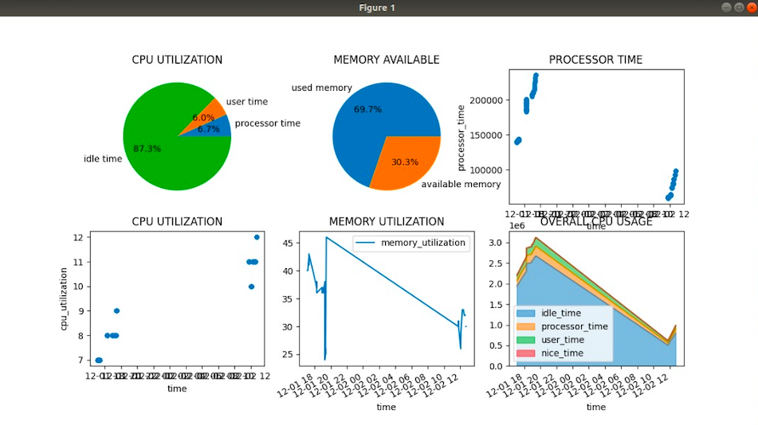
The cpu and memory resource utilisation is displayed as shown above

Slide 6
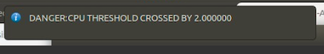
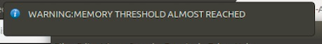
In case of any threshold violations , the data is not logged into files and a beep sound is heard along with a danger message.
If the threshold value is approaching ( buffer= -10) , a warning message is displayed.In this case , the data is logged into the file.

Slide 7
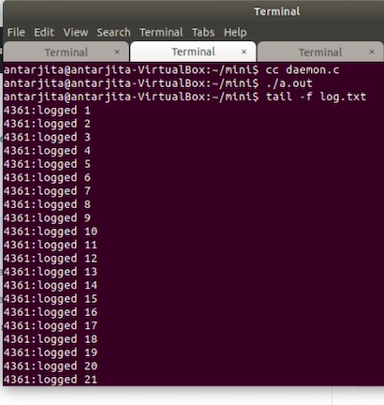
The daemon is updating the proc files
The history can be check in the file log.txt. Information regarding the errors while obtaining the proc files if any can be viewed in the log.txt file.

Slide 8
CPU Parameters
% CPU utilisation
Processor time
User time
Nice time
Idle time

Slide 9
Memory Parameters
% Memory Utilisation.
Used memory
Total memory
Free memory
Memory Available
Page table
Virtual memory used
Available pages

Slide 10
Page faults per second
Pages swapped in per second
Pages swapped out per second
Pages read per second
Pages written per second

Slide 11
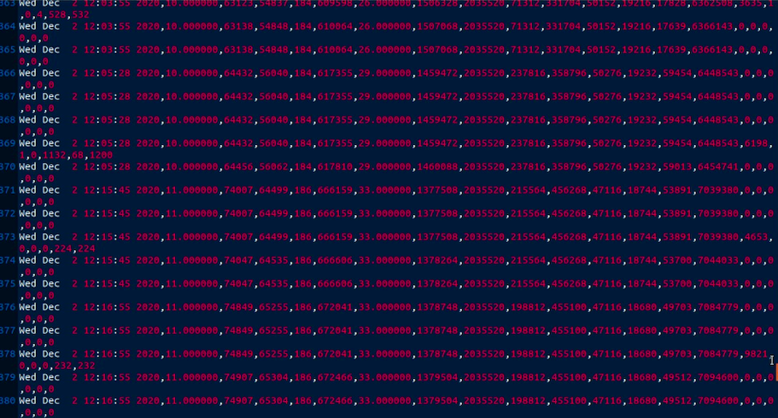
Along with the above specified parameters, the date and time is also logged into the csv file
A glimpse of the csv file is shown above.

Slide 12
We have also built a multiple linear regression model to predict the cpu and memory utilisation further on.
Thus using our tool, the user will get an idea about the manner in which the resources of the system( CPU and memory ) are utilised through graphs and log files and will receive alerts BEFORE HAND in case of excess utilisation.

Slide 13
Team Members
Name | SRN
Antarjita Mandal | PES2201800409
Sai Shruthi S | PES2201800361

